Slide 1
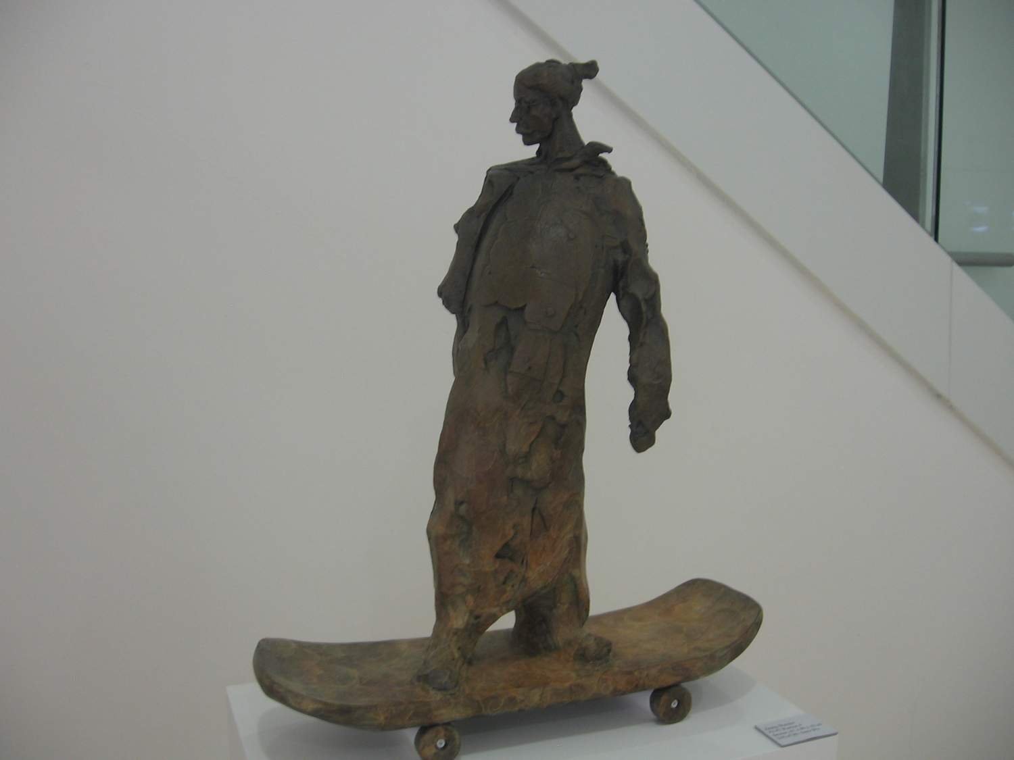
Whimsical Objects, Beauty and Inclusion in Academic Libraries
Share your examples:
https://www.menti.com Code 72 46 55 4
Sculpture at Chinese University of Hong Kong Library
Hong Kong
Anu Vedantham
IVLA Conference
September 26, 2020
Notes:
Thanks for joining my session. Please take a minute for my poll at the link in chat
https://www.menti.com/z7d9uz65aw
I’ll share the results at the end of my remarks.
My talk is titled Whimsical Objects, Beauty and Inclusion in academic libraries. I began thinking about whimsical objects after serving on the dissertation committee for Anna Carello at the University of Pennsylvania. I have included her dissertation in my references. Her work focuses on elementary school libraries and I have focused on higher education.
Visual literacy principles are key to helping academic libraries create spaces that attract and support students. University libraries are taking efforts to delineate their roles on campus in contrast to student centers, relaxation lounges in dormitories, museums, social spaces and computer labs. There is overlap of course, which makes life interesting.
This photo is from the Chinese University of Hong Kong Library - a sculpture of a man in traditional dress on a skateboard - a whimsical object to find in a library. Several photos in my talk are from the personal travels of my colleague Joan Lippincott from the Coalition of Networked Information. Skateboards will come back into my talk again later.
Since I am discussing diversity and inclusion, I will first share a little about myself. It matters to me to recognize that my perspective is biased by who I am, where I come from and the experiences I have had. I try to be explicit about the lenses I bring to my work.
I am a first generation immigrant from India. My family was wealthy when we lived in India. When I arrived at age 12 to southern New Jersey, we lived in low income housing and had significant financial challenges. This affected my comfort with academic library spaces when I joined college as an engineering student at MIT in 1985. I remember feeling nervous with the large domed spaces I encountered.
My work in academic libraries began in 2007 at the University of Pennsylvania. I was at Harvard Library for a few years and now I have joined Princeton University Library. Personal experience with libraries at wealthy institutions affects my perspective. As I get older, approaching my mid-fifties, my reactions to library spaces change. I need to remember my age lens when I speak with the 18 year olds who have entered Princeton this fall.

Slide 2
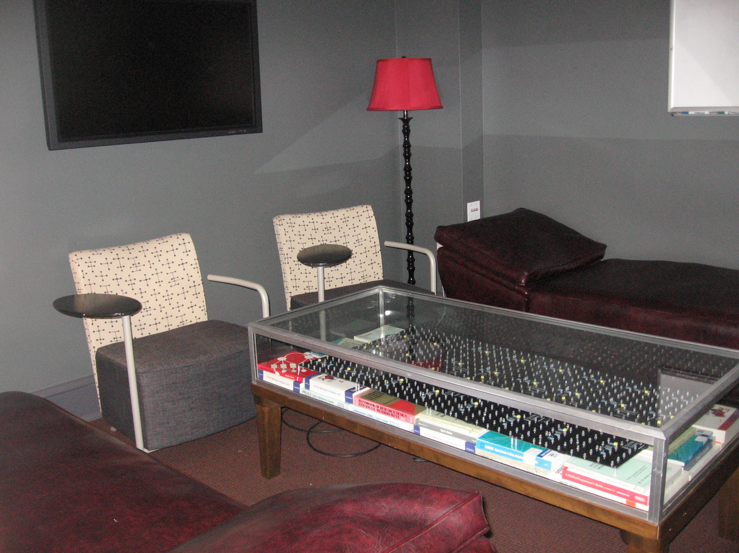
Agenda
Large library spaces - then and now
Markers of culture in academic libraries
What is a whimsical object?
Examples
How can whimsical objects help with beauty and inclusion?
Lounge with psychiatrist-type couches and games Scholars’ Lab, University of Virginia
Charlottesville VA USA
Notes:
My talk today builds on a book chapter I published recently on student-centered libraries. Here is my agenda.
I’ll talk about large library spaces and how they are evolving over time. I’ll discuss a few common markers of culture and how we are revisiting our perceptions of these markers as we consider diversity and inclusion goals. I’ll share a definition of whimsy and several examples of whimsical objects, building on local history, romantic notions of books, humor and child-like objects. I’ll conclude with speculations on how whimsical objects may help us achieve inclusion goals.
I have identified a few examples of whimsical objects, and I encourage you again to share yours on the poll link in the chat. This image from the University of Virginia Scholars’ Lab mimics a psychiatrist’s office and offers games to unwind.

Slide 3
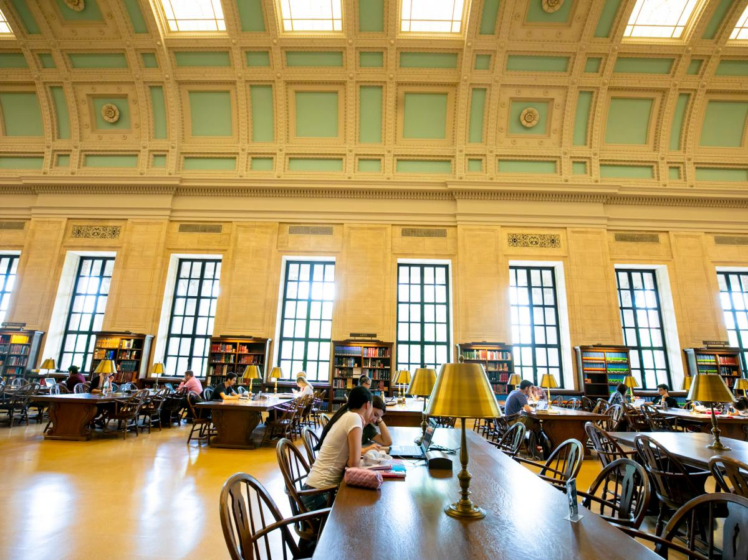
Two libraries at one university - across decades
Widener Library, Harvard University, Cambridge MA USA
Cabot Science Library, Harvard University,
Cambridge MA USA
How do concepts of beauty and inclusion inform our assessment of these two spaces?
Notes:
I’ll start with large library spaces. Many library renovations privilege transparency, light and beautiful architecture. Here are two photos from Harvard - both very beautiful spaces. The one on the left is the Loker Reading Room in Widener Memorial Library which is a traditional quiet reading room. The one on the right is in the Cabot Science Library, a renovation completed in 2018. Both are aspirational study spaces.
As you consider inclusion goals, which one would you consider more inclusive for today’s students and why? Please add your thoughts in the chat.
I observe that the space on the left has a specific cultural reference rooted in European traditions. The one on the right is modern, mostly glass and steel, and does not have a specific cultural reference.
As part of my work at Harvard, I conducted student focus groups and interviews regarding library spaces. One young man, a first-generation student in his third year of study, described walking into the room on the left in his first year, carrying his backpack. He stared at a large number of people sitting in absolute silence, turned around and never entered the room again. After hearing his anecdote, library administrators conducted outreach to first-generation students, bringing them into the space to connect informally with librarians and meet with the university’s president. We recognized that we needed to be proactive to make the space on the left work in terms of inclusion.
The space on the right did not require such proactive intervention.

Slide 4
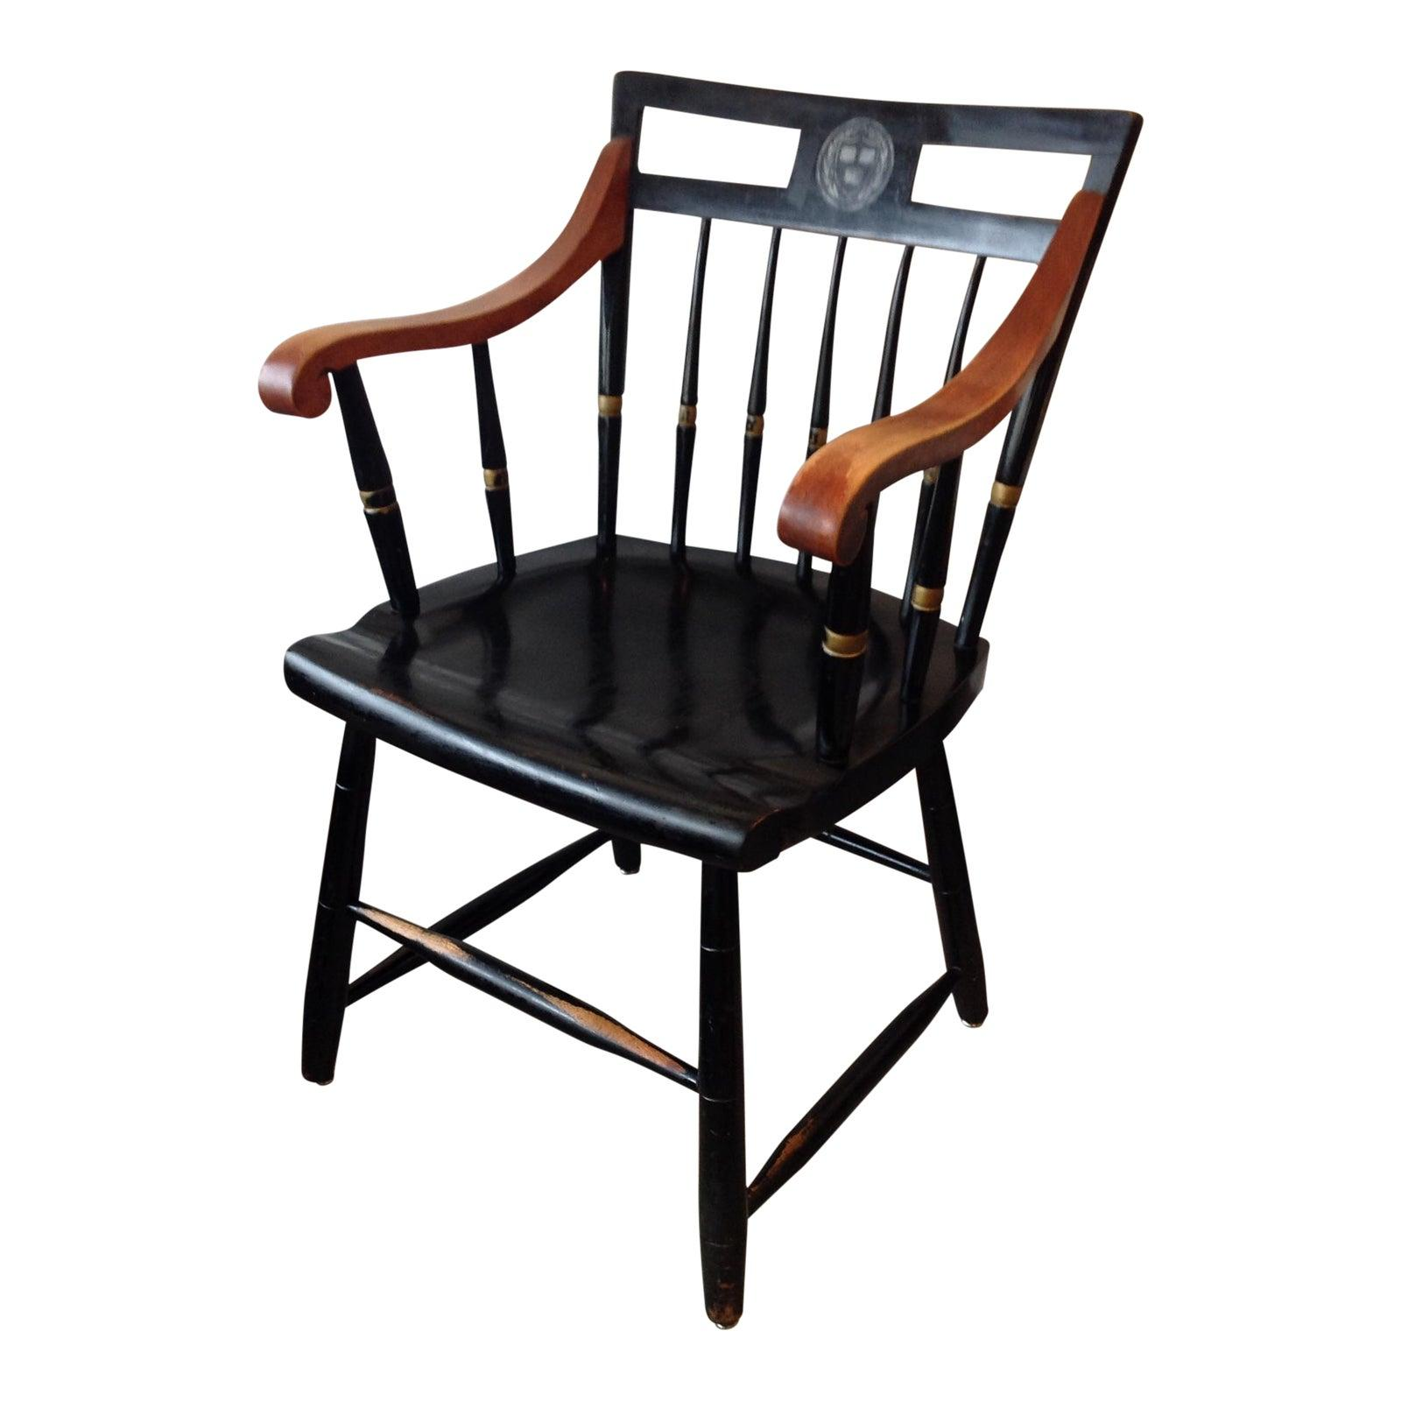
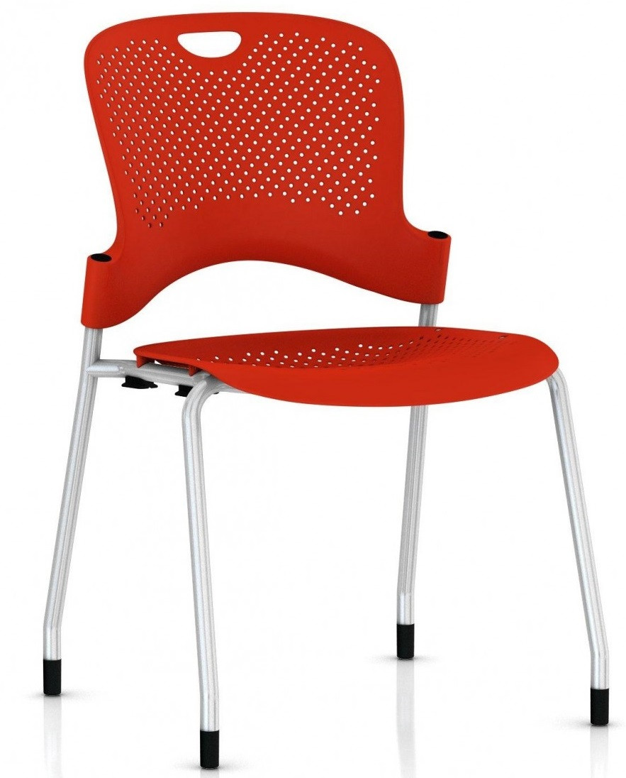
Markers of culture in library spaces
Architecture - ceilings, pillars, colors, textures
Visual Cues
Portraits - who is featured? Do we know why?
Sculpture - busts, especially
Artwork in general - Who donates them? Who decides what is included?
Interior Design and Furniture
Chairs!
Flexibility
Signage
How do you measure inclusion in a library space?
Notes:
As I reflect on library spaces and listen to students and faculty, I become more sensitive to markers of culture. Architecture, portraiture, interior design and signage all send explicit and implicit messages to students about appropriate behaviors, inclusion and belonging.
I observe the role of ceilings (high versus low, colors and ornaments), pillars (reminders of Greek buildings), colors, patterns and textures. I note visual cues. The issue of portraits is well studied - the effect of seeing a wall of portraits of people who do not look like you who have given large financial gifts to the university in the past. For any portrait featured in an academic library today, I would ask several questions - Who is featured and why, Who made the decision to feature this particular person? Do we still need to feature this person in this space? What are the opportunity costs of keeping this portrait where it is today?
Sculpture can be similar. Many traditional library spaces feature busts of leaders from university history, raising again the issue of role models.
Furniture can bring up interesting questions, especially regarding accessibility and body image issues. Here is a photo of two types of chairs popular at Harvard Library and I notice how different the cultural signals are.
If spaces are flexible, they signal the role of the student - can they control their environment? Do they feel ownership of the space or do they feel like they have been given permission to enter a space that belongs to someone else.
Signage is something that librarians have often stopped seeing. On the more mundane side, simple and effective signage impacts library usage and popularity. Student feedback on signs, especially from new arrivals to campus, can be very helpful.
How do you measure inclusion in a library space? I would say by measuring student behavior. Pay attention to who walks in and leaves right away, and who stays for the day. What do you see in their body language? Are they comfortable? Are they productive? Do they share suggestions for improvement with library staff?

Slide 5
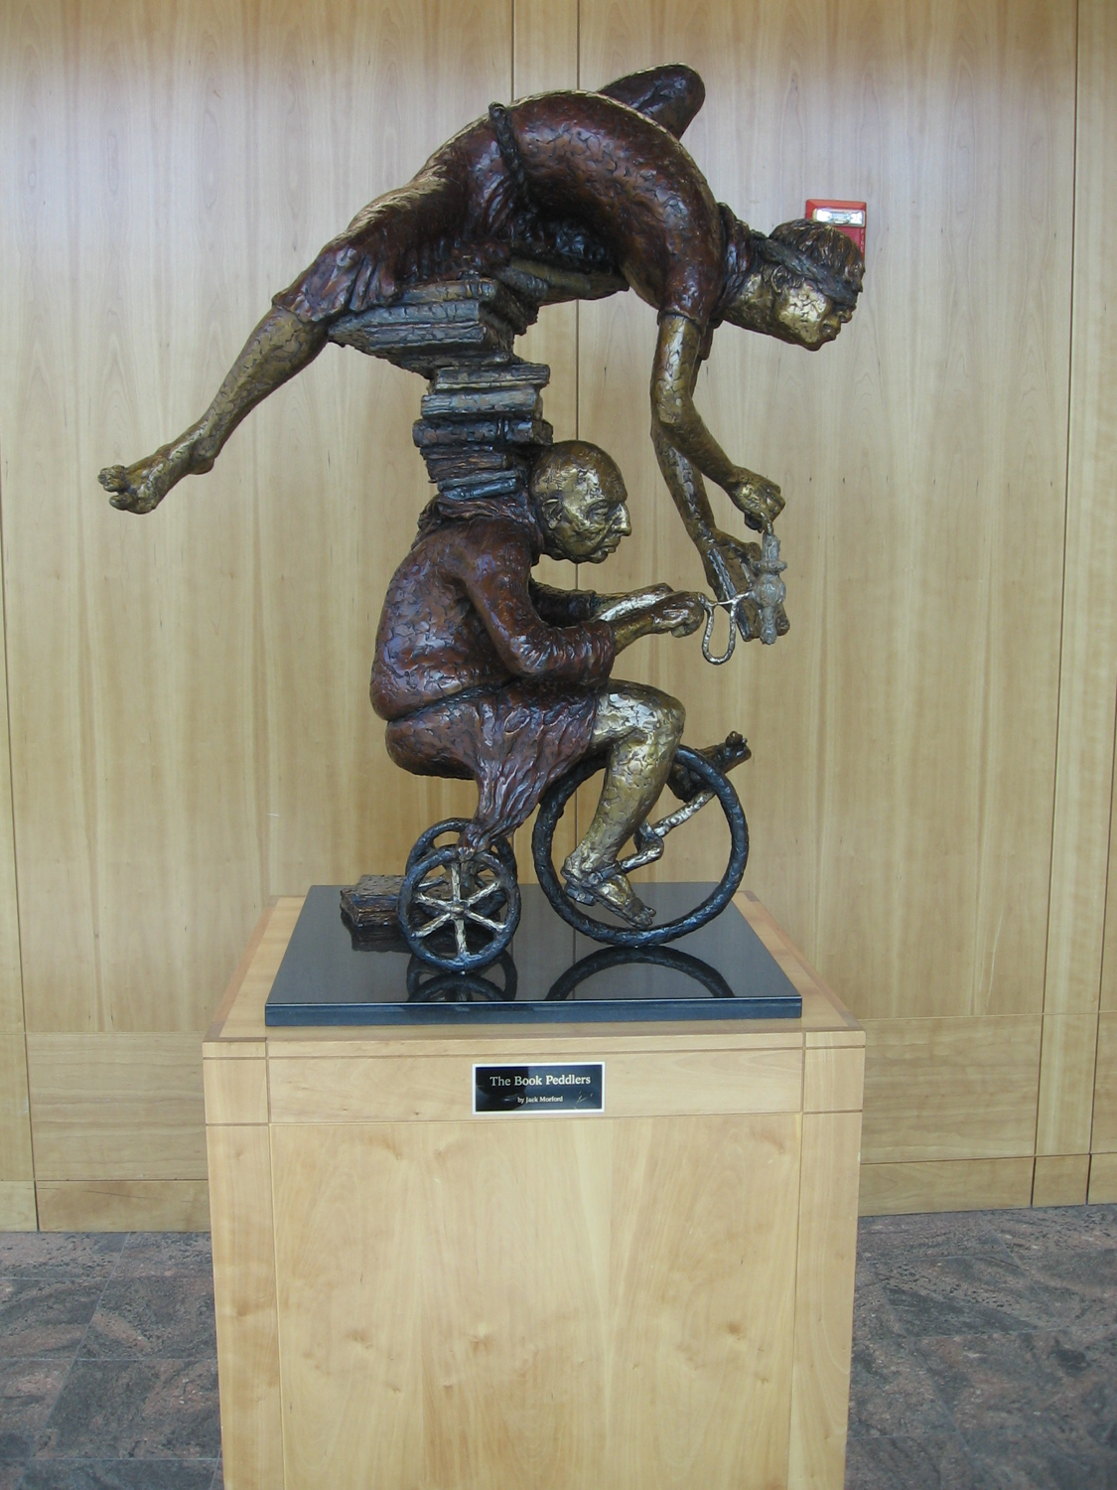
Definition of whimsy
1: Whim, Caprice
2: the quality or state of being whimsical or fanciful
3: a fanciful or fantastic device, object, or creation especially in writing or art
“The Book Peddlers” Sculpture, Harold B. Lee Library, Brigham Young University, Provo UT USA
Notes:
Here is the definition of whimsy from the Merriam Webster dictionary.
1: Whim, Caprice
2: the quality or state of being whimsical or fanciful
3: a fanciful or fantastic device, object, or creation especially in writing or art
I will explore how adding whimsical objects could help library spaces feel more inclusive to students who are not traditionally part of the culture already expressed in that library.
I especially like objects that make fun of library work - reimagining how books and book-related technology can be presented - being able to laugh at ourselves can really help with inclusion. This image shows two very talented book sellers who can balance books and bicycle at the same time. The concept of vocational awe in libraries - the assumption that library work is inherently good and helpful to society - is worth exploring - a sculpture like this one helps us not to take ourselves too seriously.

Slide 6
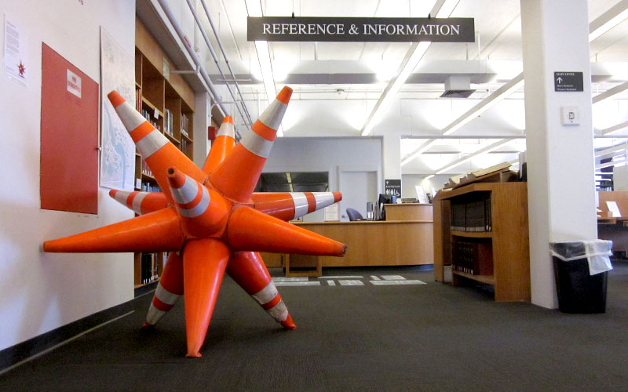
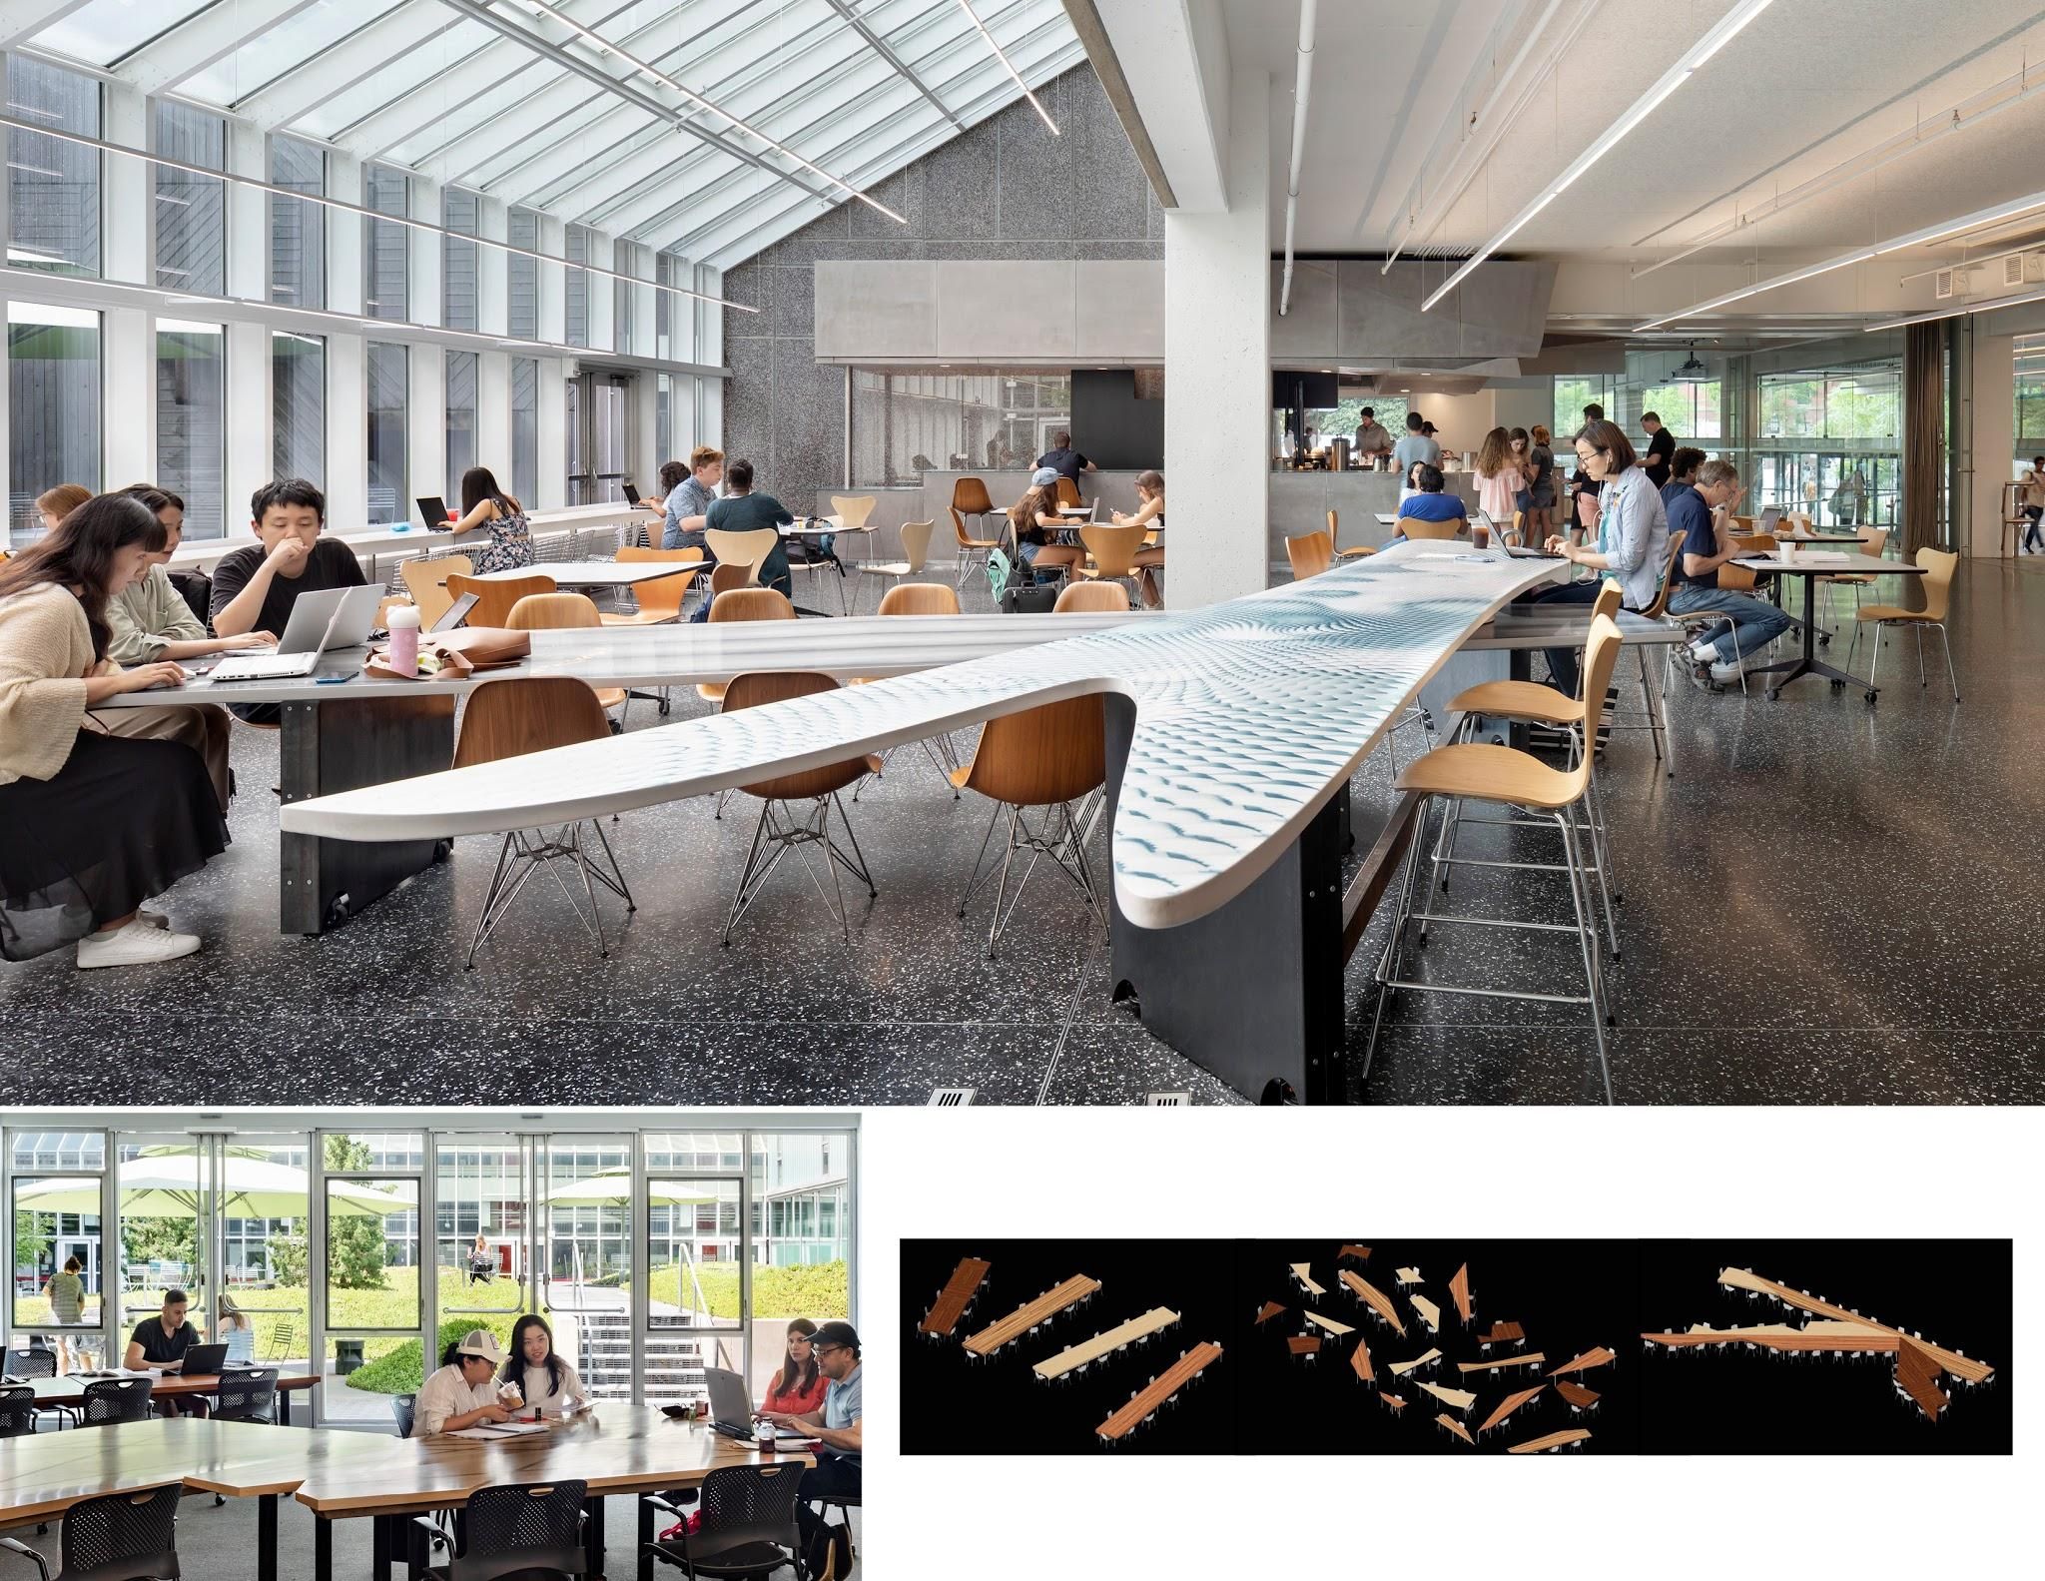
Images from 2011 and 2018 of the Cabot Science Library at Harvard University, Cambridge MA USA
Notes:
Here are two examples from the Cabot Science Library at Harvard. The item on the left is artwork made in 2011 and exhibited in the library prior to renovation. Created by Dan Stenof Beyer and titled “Reuse, Renew, Recycle: Different ways of Thinking about Trash” it includes 12 traffic cones retrieved from industrial dumpsters. The geometric shape is designed to be touched and moved around.
The photo on the right is from the same library seven years later and is a large fish-shaped table just outside the library entrance. The fish has fins that move and it can be separated into its parts.

Slide 7
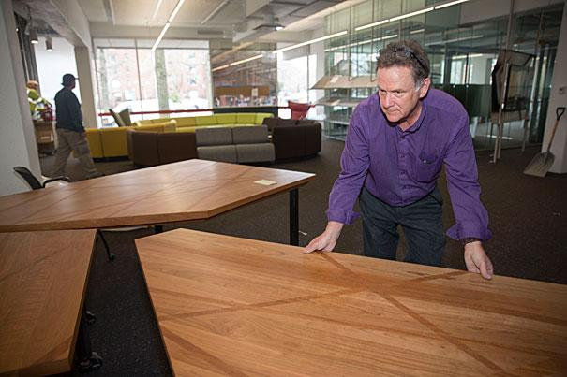
Puzzle Tables (2018)
Cabot Science Library
Harvard University
Cambridge MA USA
Notes:
Another example of a whimsical object that is also practical furniture is deeper inside Cabot. Here are the puzzle tables. At top right is the overall design - several dozen irregular pieces that can be assembled into neat rectangles. At bottom right, you can see how the table pieces move around and line up in creative ways with lines and textures to connect them. The third picture shows students studying at the tables in one configuration. The library randomizes the tables each Thursday morning to give students a mid-week surprise. Students can move the tables around easily and some pieces are wheel-chair height.

Slide 8
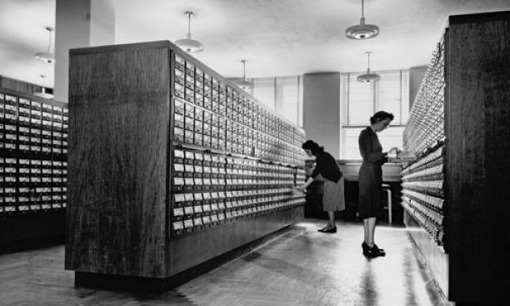
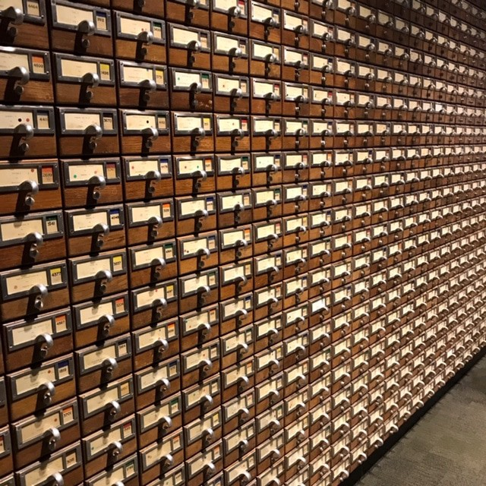
Local and institutional history
Building on local library history at Firestone Library, Princeton University
Princeton, NJ USA
Notes:
This slide and the one following share ideas about being whimsical with history. The past can be played with. On the left is the card catalog at Firestone Library at Princeton - with diligent librarians doing the lookup that is now done on computers. We haven’t used the card catalog in decades but it stayed in the library getting dusty. My office is in this library so I know it well. One creative decision during the renovation was to take the fronts of the catalog drawers and line a large wall at the entrance from floor to ceiling. A funny side effect of this is the number of visiting librarians who express unhappiness that the drawers are not in order! Alums love this wall and so do new students who take selfies for Instagram. There is something about it that is both ridiculous and charming.

Slide 9
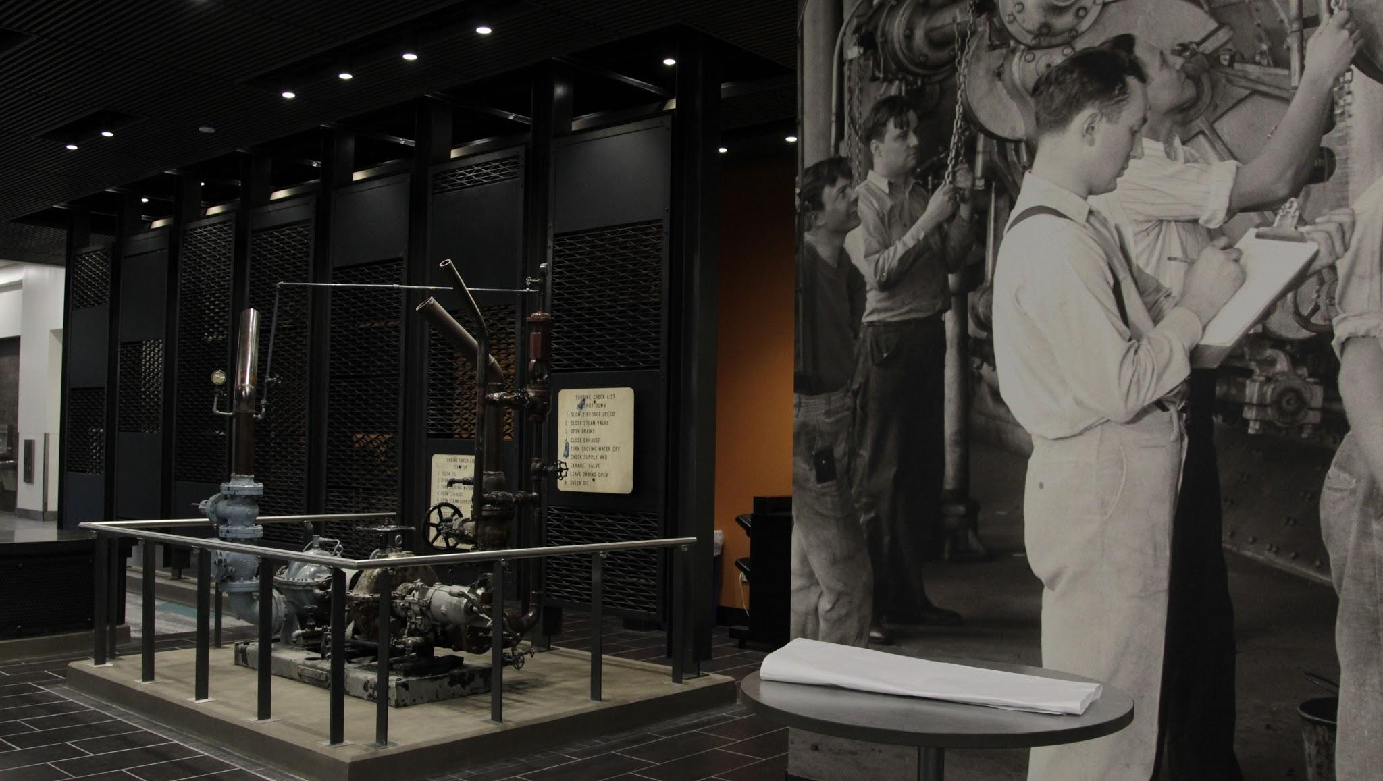
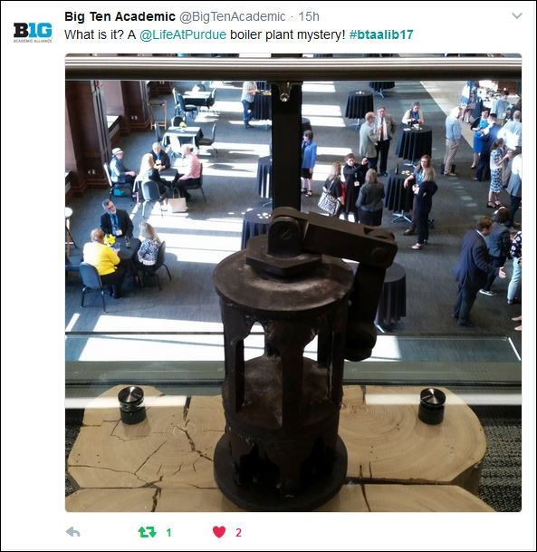
Local and institutional history (2)
Boiler parts on display at Wilmeth Active Learning Center, Purdue University, Lafayette, IN USA
Notes:
My second example about history is from Indiana. Purdue University recently created the Wilmeth Active Learning Center. It’s quite the modern space with whiteboards, rolling chairs and bright colors.
Purdue’s sports teams are called the Boilermakers in honor of the town’s history with railroad shops and boiler part factories. The new library features a variety of cryptic objects important to boiler construction. Not exactly what you might expect to find in a library! As you can see in the right photo, this can lead to Insta-worthy moments. The photo on the left is reminiscent of a museum space. Many academic libraries are adding spaces similar to science and art museums. In Firestone Library, we have a full gallery on the first floor featuring a new exhibition once every few months.

Slide 10
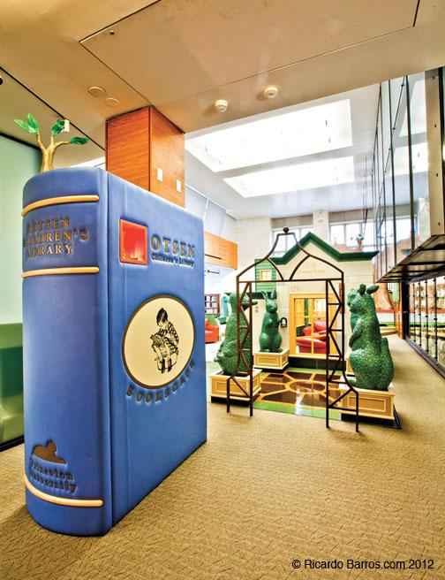
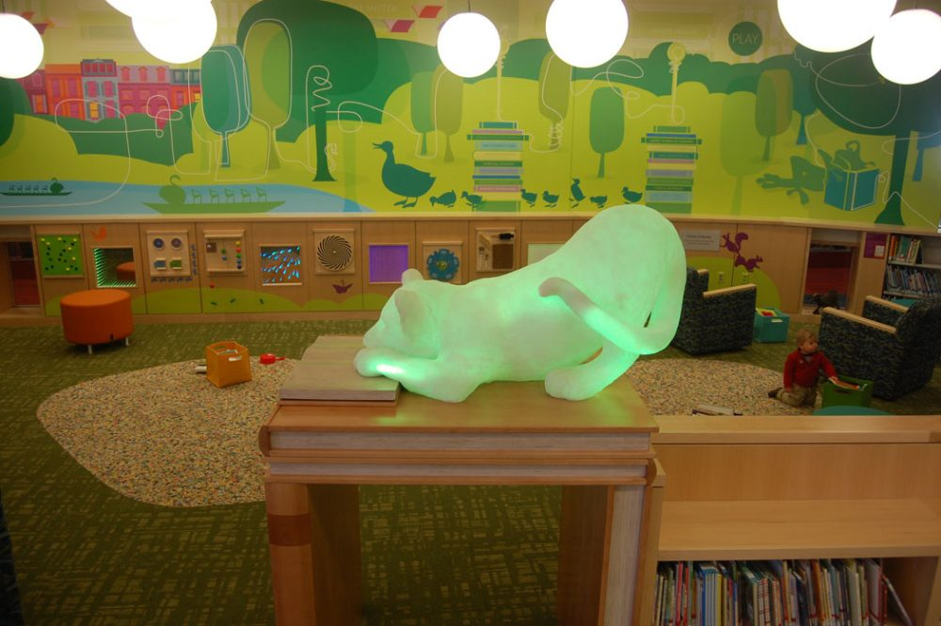
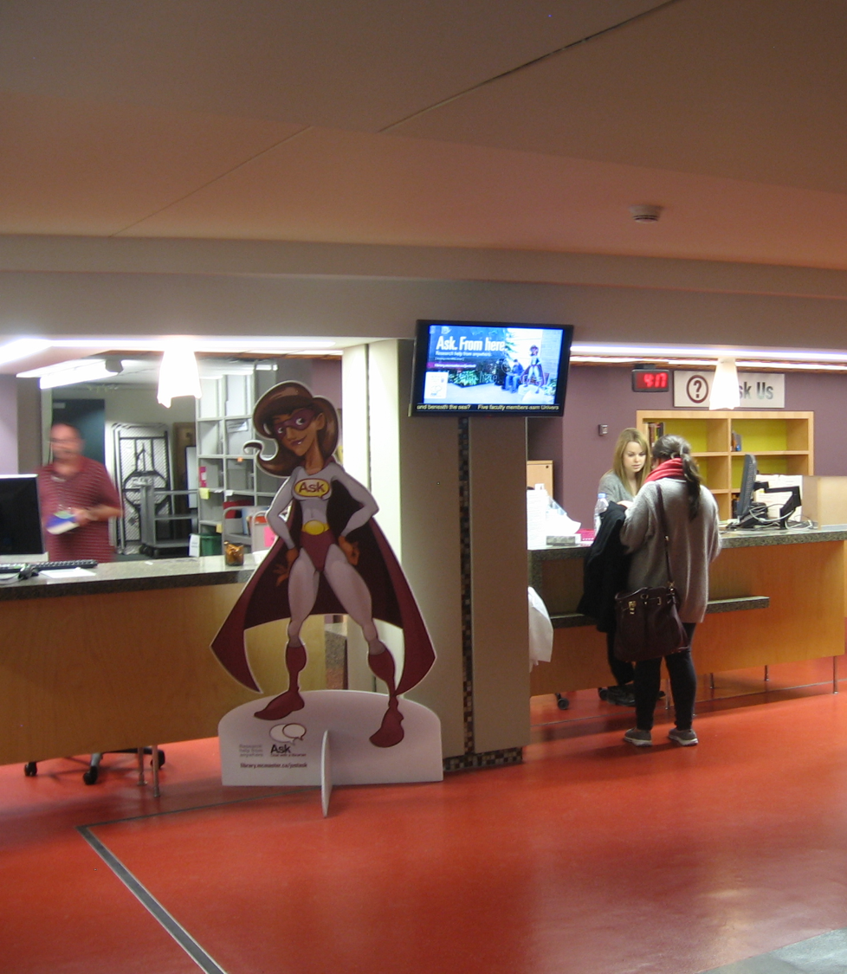
Child-friendly spaces as inspiration
Children’s Library
Boston Public Library - Central Branch, Boston, MA USA
Action figure at Checkout
McMaster University Library Hamilton, Ontario, Canada
Cotsen Children’s Library
Firestone Library,
Princeton University, Princeton, NJ USA
Notes:
Anna Carello’s dissertation on K-3 school libraries includes several great photos. Here are two examples of child-friendly spaces within libraries. Cotsen’s Children's library in Firestone Library includes many oversized objects that children can climb on. There is a puppet theater and many cozy corners. Boston Public Library’s light-up lion cub references the formal lion sculpture in a different part of the building that was not renovated. The architects recognized that the library was associated with lions and they reinterpreted this with a lion cub that is playfully perched on a shelf.

Slide 11
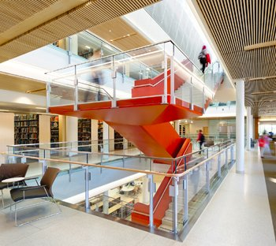
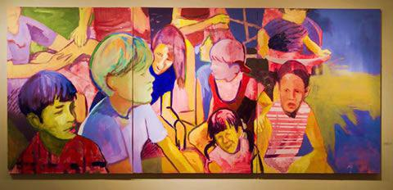
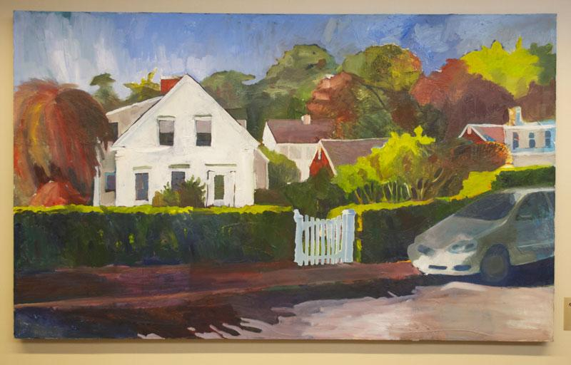
Student / alum created artwork
Frederick E. Berry Library and Learning Commons, Salem State University, Salem, MA USA
Notes:
I appreciated the decision by the Salem State Library to commission artwork from their students and alums as part of their renovation planning. It may not be whimsical but it does reflect student creativity.

Slide 12
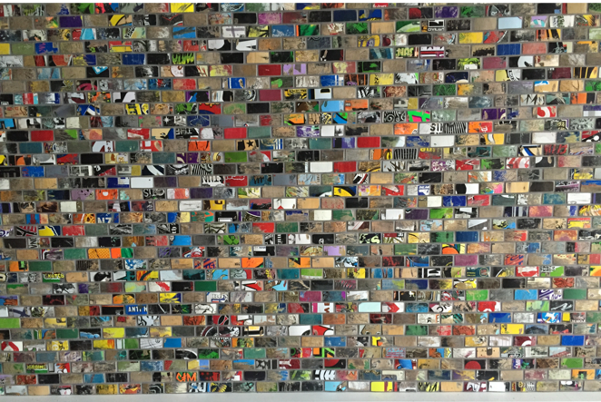
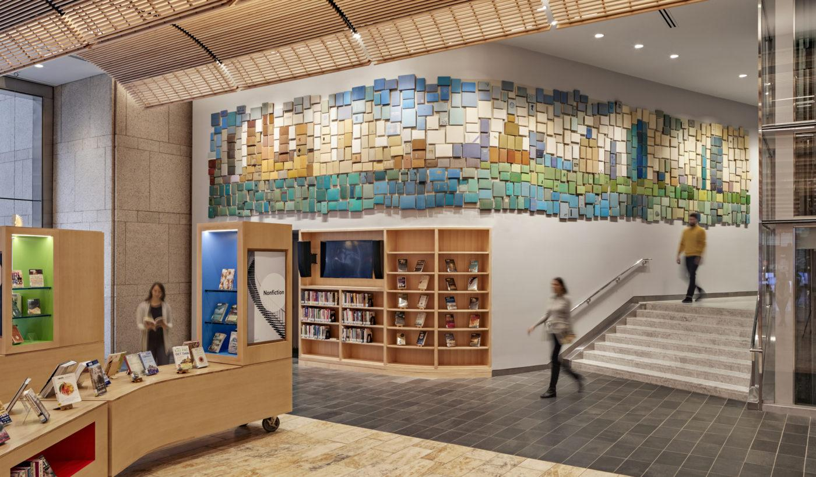
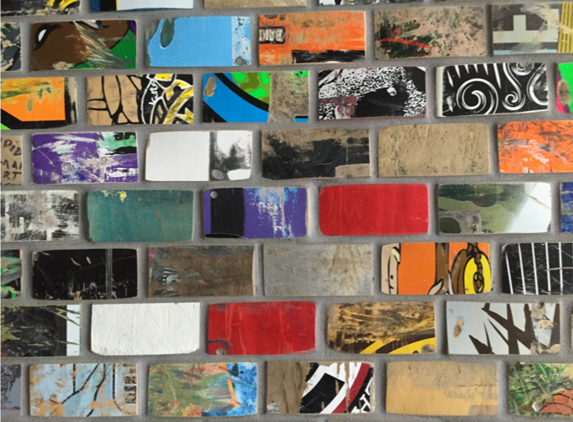
Wall Surfaces
Wall tiles made of skateboards at Mount Royal University Library,
Alberta, Canada
Front entrance - Book cover wall
Boston Public Library - Central Branch
Boston, MA USA
Notes:
This is my last slide of photos. I’d like to mention the potential of wall surfaces. Whimsical objects don’t need to take up valuable space. The photo on the left is from the entrance of the Boston Public Library. During the renovation, they found books scheduled to be discarded, sorted them by the color of their covers and used them to create the wall sculpture. The books are reachable as you walk by the wall.
On the right is a wall made of skateboards in Alberta, Canada. This skateboard wall is opposite the elevators as you enter the library. Again, a very touchable surface.

Slide 13
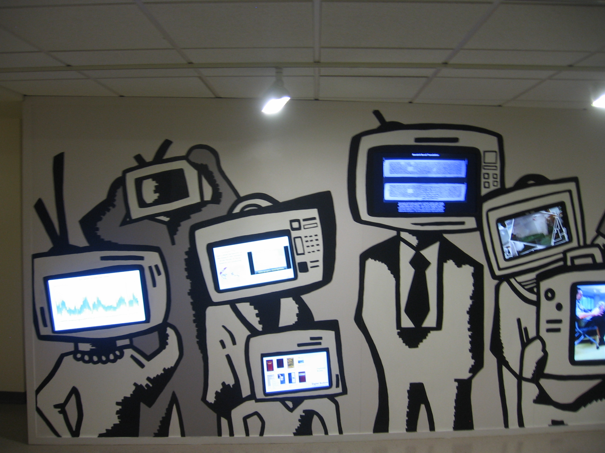
Wall Surfaces (2)
Entrance Wall
Centre for Digital Scholarship
McMaster University Library Ontario, Canada
Notes:
The last photo I will share is of a playful wall outside the Centre for Digital Scholarship at McMaster University. Again, I note the touch of self-deprecating humor.

Slide 14
How can whimsical objects help with inclusion?
Design charrette with student and faculty participation
Observation of behaviors versus asking of questions
Where do students gather today? What can we learn from those spaces?
Staff involvement in renovation planning - “fresh eyes”
What can we learn from how museums function?
Notes:
I will conclude with a few thoughts. Library renovations can actively reflect the opinions and perspectives of a diverse student body. A few simple techniques for capturing student perspectives, involving staff in visualization exercises and creating visioning documents can help a library renovation maintain commitment to visual literacy principles.
Renovations often create challenges to governance aspects of library and campus administration. Tensions between the motivations and constraints faced by architectural firms and the day-to-day needs of library service providers can play out in what gets included in a renovation and how. Having a clear roadmap on user experience and inclusion considerations can help administrators to make better decisions when a renovation is underway. Such planning can help when decision making needs to happen quickly and behind closed doors.
A design charrette is a great technique for engaging students and faculty with rethinking a new space. It involves a guided exercise with photo elicitation and post-it notes. By encouraging visual thinking and group creativity, it can unearth people’s assumptions and preferences.
It is really important to observe behaviors rather than ask questions. Often, when I meet with faculty, they will apologize that they have not come to the library to browse the stacks. I am tempted to reply that my job is not to force them to use the library in antiquated ways. By observing how students and faculty actually use, or not use, library spaces, I can make better decisions.
It’s also really important to leave the library. Where do your students gather today? What can we learn from those spaces? Why are they studying in places that are surprising to us as librarians?
It’s important to involve staff in renovation planning but also important to look at spaces with fresh eyes. Asking staff from one library location to help reimagine another library location can be powerful. It’s hard to notice what is around you in a space you see every day.
The last question is what can libraries learn from how museums function. Museums understand the importance of planning and scheduling exhibitions and then closing them down, and the value of surprise and joy as visitors enter the space. Libraries can learn from museum practices.

Slide 15
Readings
Carello, Anna, "The Impact of School Library Design on the Development of Multiple Literacy Skills in Early Childhood Students" (2017). Dissertations available from ProQuest. AAI10265345. Online at https://repository.upenn.edu/dissertations/AAI10265345
Huang, Joanna and Vedantham, Anu, “Cabot Science Library: Creating Transformative Learning Environments in Library Spaces” in Cases on Smart Learning Environments, IGI Global, 2019. Online at https://www.igi-global.com/chapter/cabot-science-library/219032
Vedantham, Anu, “Student-Centered Libraries: Changing both expectations and results” in The Routledge International Handbook of Student-Centered Learning and Teaching in Higher Education, Taylor & Francis, 2020. Online at https://www.taylorfrancis.com/books/e/9780429259371/chapters/10.4324/9780429259371-34
Notes:
Here are my references.

Slide 16
Photo Credits
Several personal photos provided by Joan Lippincott, Associate Executive Director Emerita at the Coalition for Networked Information (CNI):
McMaster University, Chinese University of Hong Kong, University of Virginia, Brigham Young Library, Mount Royal University Library
Harvard’s Widener Library: https://library.harvard.edu/events/tour-widener-library
https://www.chairish.com/product/534843/vintage-harvard-university-windsor-chair-by-nichols-stone
Herman Miller Chair: https://www.hermanmiller.com/products/seating/stacking-chairs/caper-stacking-chair/design-story/
Cabot Science Library:
2011: https://thehinge.net/2011/protectedknowledge/index.html
2018: https://www.aiaga.org/design-award/pritzker-commons-and-godfrey-lowell-cabot-science-library-transformation-science-center/
https://news.harvard.edu/gazette/story/2017/04/harvards-cabot-science-library-charges-into-the-future/
Princeton’s Firestone Library:
https://paw.princeton.edu/article/firestones-card-catalog-now-its-just-memory
https://planetprinceton.com/2019/03/11/a-decade-in-the-making-firestone-library-renovations-are-now-complete/
https://paw.princeton.edu/article/final-scene-40
Purdue:
https://www.jconline.com/story/news/college/2017/08/03/inside-purdues-new-79-m-active-learning-center/525129001/
http://blogs.lib.purdue.edu/news/2017/05/17/libraries-host-big-ten-academic-alliance-library-conference/
Salem State:
https://americanlibrariesmagazine.org/salem2/
http://w3.salemstate.edu/~mmalloy/artwork/index.html
Boston Public:
https://www.arrowstreet.com/portfolio/bpl-interior-decor/
https://www.wbur.org/artery/2015/02/21/boston-library-renovation
Notes:
Here are my photo credits

Slide 17
Questions / Comments?
Menti Responses
Contact Anu Vedantham at anuv@princeton.edu
Notes:
I will now open up the poll results and take your questions.
Menti Results

